Slide 1
Home automation

Slide 2
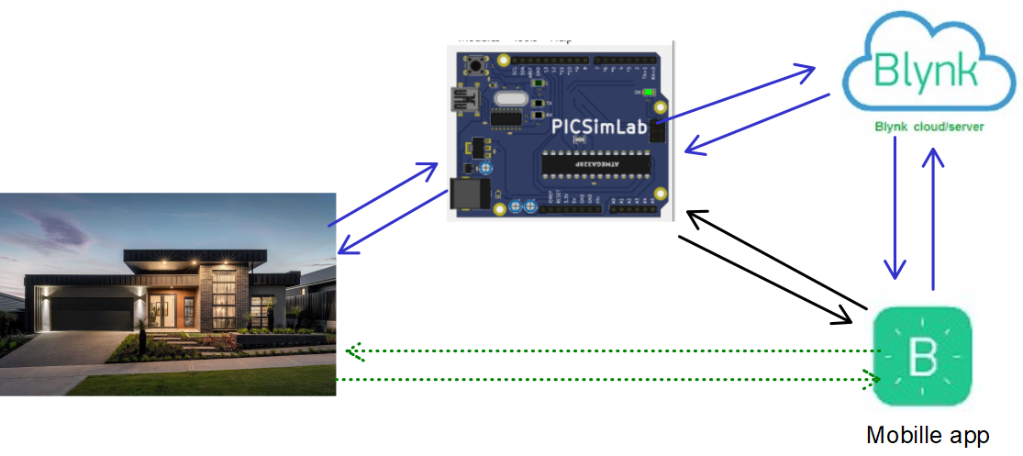

Arduino

Slide 3
Arduino
Requirements
LED
Temperature system(ADC)
LDR
Serial tank(Serial communication)
Ethernet Sheild
Blynk Iot app

Slide 4
Light Emitting Diodes

Slide 5
Arduino
Interface - LEDs
Simplest device used in most on the embedded applications as feedback
Works just like diodes
Low energy consumption, longer life, smaller size, faster switching make it usable in wide application fields like
  Home lighting,
  Remote Controls, Surveillance,
  Displays and many more!!

Slide 6
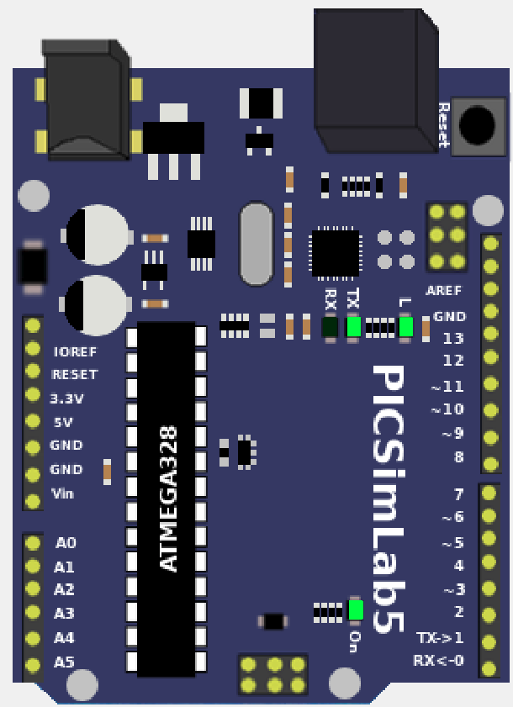
Arduino
Interface - LEDs
R1
GPIO13
D1
GND

Slide 7

Arduino
Classes – Digital I/O - pinMode()
Description | Configures the specified pin to behave either as an input or an output
Syntax | pinMode(pin, mode)
Parameters | pin: the number of the pin whose mode you wish to set mode: INPUT, OUTPUT, or INPUT_PULLUP. (see the (digital pins) page for a more complete description of the functionality.)
Return | Nothing
Notes and Warnings | The analog input pins can be used as digital pins, referred to as A0, A1, etc.

Slide 8
Arduino
Classes – Digital I/O - digitalWrite()
Description | Write a HIGH or a LOW value to a digital pin.
Syntax | digitalWrite(pin, value)
Parameters | pin: the pin number value: HIGH or LOW
Return | Nothing

Slide 9
Arduino
Classes – Digital I/O - digitalRead()
Description | Reads the value from a specified digital pin, either HIGH or LOW.
Syntax | digitalRead(pin)
Parameters | pin: the number of the digital pin you want to read
Return | HIGH or LOW

Slide 10
Arduino
Classes – Time - delay()
Description | Pauses the program for the amount of time (in milliseconds) specified as parameter. (There are 1000 milliseconds in a second.)
Syntax | delay(ms)
Parameters | ms: the number of milliseconds to pause (unsigned long)
Return | Nothing

Slide 11
CLCD

Slide 12
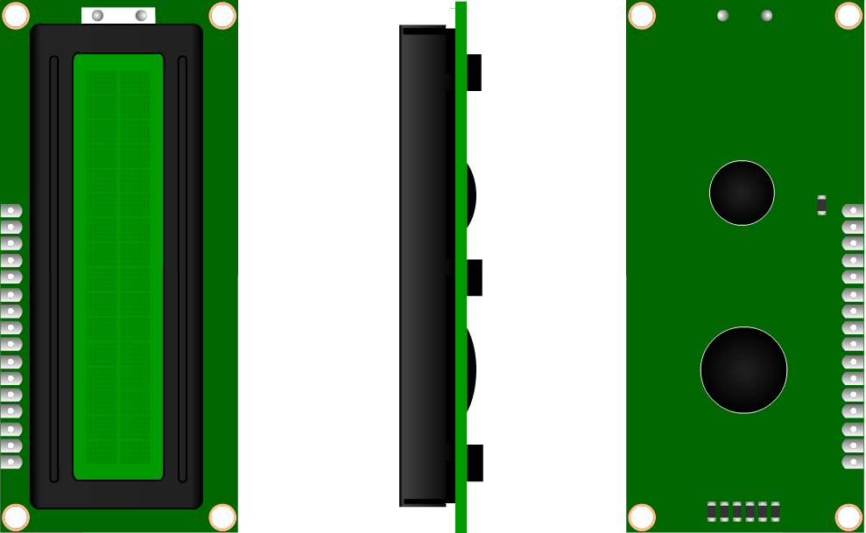
Arduino
Interface - CLCD
Most commonly used display ASCII characters
Some customization in symbols possible
Communication Modes
  8 Bit Mode
  4 Bit Mode

Slide 13
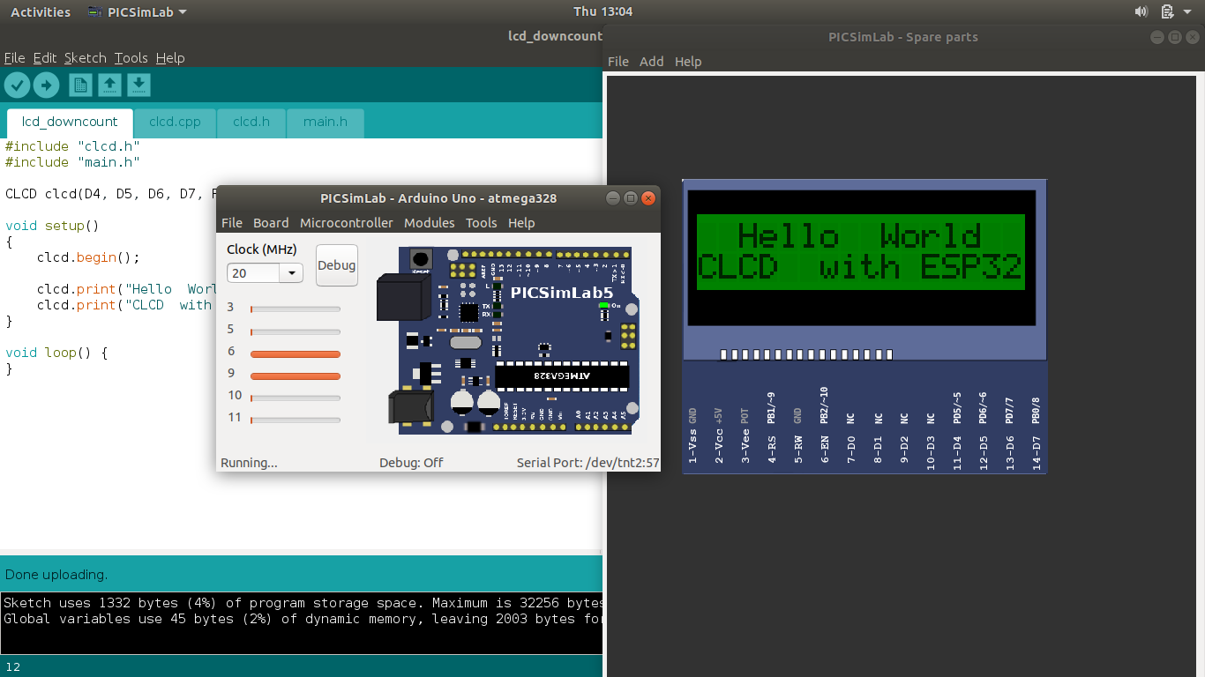
Arduino
Interface - CLCD

Slide 14
Arduino
Classes – Communication – Serial.begin()
Arduino
Classes – LiquidCrystal_I2C – LiquidCrystal_I2C(address, columns, rows)
Description | Set the LCD address and no of display lines and characters in line
Syntax | LiquidCrystal_I2C(adress,columns,rows)
Parameters | columns: No of characters in each line rows: No of display lines

Slide 15
Arduino
Classes – Communication – Serial.begin()
Arduino
Classes – LiquidCrystal_I2C – setCursor(columns, rows);
Description | Set Cursor at particular position
Syntax | setCursor(columns,rows)
Parameters | columns:character position rows: line number

Slide 16
Arduino
Classes – Communication – Serial.begin()
Arduino
Classes – LiquidCrystal_I2C – print(string);
Description | To print the string on the CLCD
Syntax | print(string)
Parameters | string - string to be printed on the CLCD

Slide 17
Arduino
Clasgin()
Arduino
lcd.init(); lcd.backlight(); lcd.clear(); lcd.home(); | // initialize the lcd //Turn ON the back light //Clear the CLCD screen //Set cursor to the first position on the clcd

Slide 18
Analog Input

Slide 19
Arduino
Interface – Analog Inputs
Very important peripheral in embedded systems for real time activities
The controller understands only digital signals, so an real time linear signals have to be converted into digital form
Multiplexed with GPIO
Comes with different architecture, SAR is most commonly used

Slide 20
Arduino
Interface – Analog Inputs
Types of ADCs:
1) Flash ADC
2) Pipelined
3) SAR
4) Dual-scope
5) Sigma delta

Slide 21
Arduino
Interface – Analog Inputs
Analog Inputs - Introduction
● Resolution:
→ ADC Register Width
→ 8bit : 0 – 255
→ 10bit : 0 – 1023
→ 12bit : 0 – 4095

Slide 22
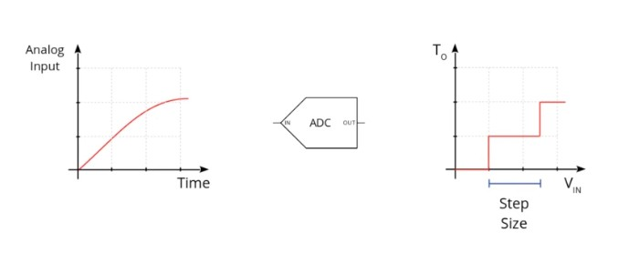
Arduino
Interface – Analog Inputs
Step Size:(LSB)
→ Minimum change resolved
step size = Input Range / 2 ^ (resolution)

Slide 23
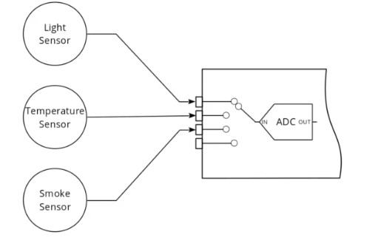
Arduino
Interface – Analog Inputs
Full Scale Range (FSR):
Max Representable Amplitude
Channel:

Slide 24
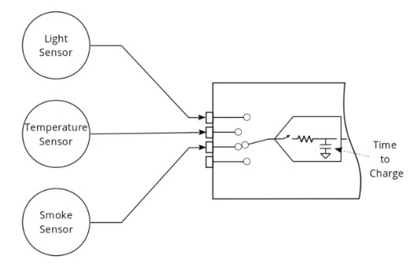
Arduino
Introduction – Analog Inputs
Acquisition Time:
Conversion Time:

Slide 25
Arduino
Classes – Analog I/O - analogRead()
Description | Reads the value from the specified analog pin. The number of channels depends on the board used, assuming 10-bit analog to digital converter, mapping voltages between 0 and 5 volts into integer values between 0 and 1023. This yields a resolution between readings of: 5 volts / 1024 units or, .0049 volts (4.9 mV) per unit. The input range and resolution can be changed using analogReference(). It takes about 100 microseconds to read an analog input,
Syntax | val = analogRead(pin)
Parameters | pin: the number of the analog input pin to read from
Return | int (0 to 1023) Depends on the board
Notes and Warnings | If the analog input pin is not connected to anything, the value returned by analogRead() will fluctuate based on a number of factors (e.g. the values of the other analog inputs, how close your hand is to the board, etc.).

Slide 26
PWM

Slide 27
Arduino
Interface –PWM(analog output)
●Sometimes called as PDM (Pulse Duration Modulation)
●A technique used to vary the active time vs inactive time in
a fixed period.
● Mostly used to control the average voltage of the Load
connected.
● Used in wide applications like Motor Controls, Lamp
Dimmers, Audio, Power Controls and many more..

Slide 28
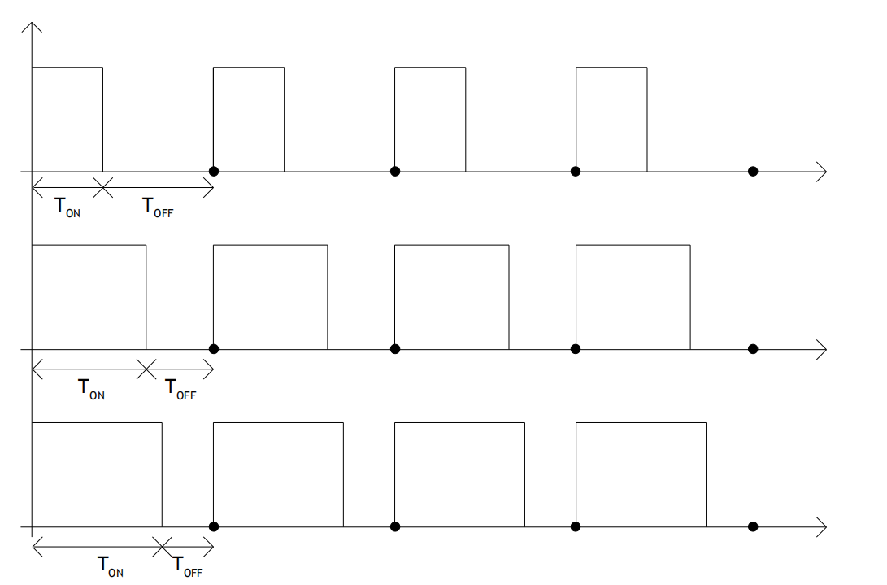
Arduino
Interface –PWM

Slide 29
Arduino
Classes – Analog I/O - analogwrite()
Description | Writes an analog value (PWM wave) to a pin. Can be used to light a LED at varying brightnesses or drive a motor at various speeds
Syntax | analogWrite(pin, value)
Parameters | pin: the pin to write to. Allowed data types: int. value: the duty cycle: between 0 (always off) and 255 (always on). Allowed data types: int
Return | Nothing

Slide 30
Serial Tank

Slide 31
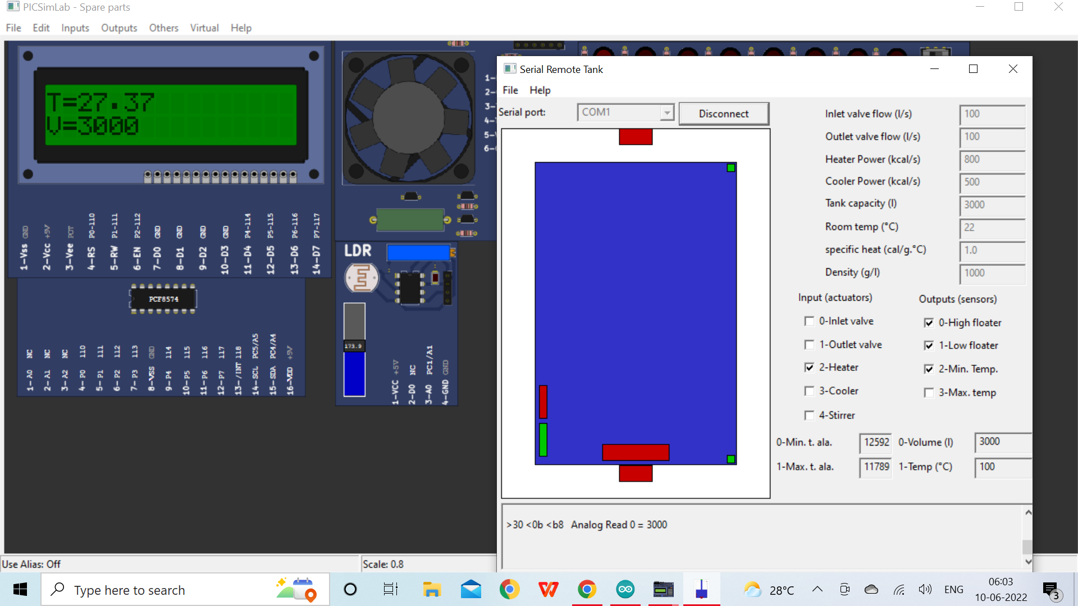
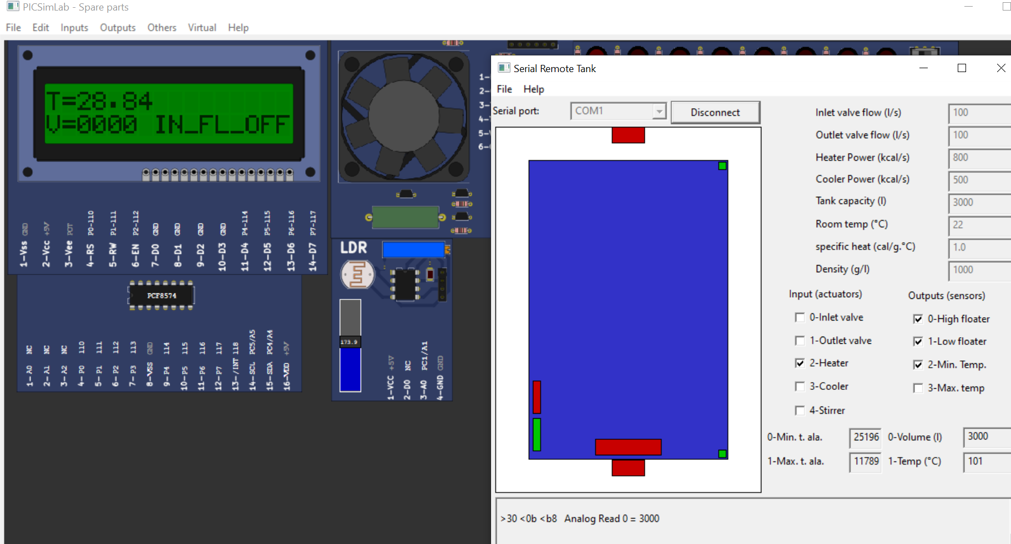
Arduino
COM1 port on Serial tank
COM0 port on arduino

Slide 32
Arduino
Classes – Communication – Serial.begin()
Arduino
Classes – Communication – Serial.begin()
Description | Sets the data rate in bits per second (baud) for serial data transmission
Syntax | Serial.begin(speed) Serial.begin(speed, config)
Parameters | speed: in bits per second (baud) – long config: sets data, parity, and stop bits. Some valid values are SERIAL_5N1 SERIAL_6N1 SERIAL_7N1 SERIAL_8N1 (the default)
Return | Nothing

Slide 33
Arduino
Classes – Communication - Serial.write()
Arduino
Classes – Communication - Serial.write()
Description | Writes binary data to the serial port. This data is sent as a byte or series of bytes; to send the characters representing the digits of a number use the print() function instead.
Syntax | Serial.write(val) Serial.write(str) Serial.write(buf, len)
Parameters | val: a value to send as a single byte str: a string to send as a series of bytes buf: an array to send as a series of bytes
Return | size_t: write() will return the number of bytes written, though reading that number is optional

Slide 34
Arduino
Classes – Communication - Serial.read()
Arduino
Classes – Communication - Serial.read()
Description | Reads incoming serial data. read() inherits from the Stream utility class.
Syntax | Serial.read()
Parameters | Nothing
Return | The first byte of incoming serial data available (or -1 if no data is available) - int.

Slide 35
BLYNK

Slide 36
Arduino
BLYNK
Blynk is a full suite of software required to prototype, deploy, and remotely manage connected electronic devices at any scale: from personal IoT projects to millions of commercial connected products.
With Blynk anyone can connect their hardware to the cloud and build a no-code iOS, Android, and web applications to analyze real-time and historical data coming from devices, control them remotely from anywhere in the world, receive important notifications, and much more…

Slide 37
Arduino
Classes – Communication - Serial.read()
Arduino
Classes – Blynk BLYNK_WRITE(vpin)
Description | BLYNK_WRITE is a function called every time device gets an update of Virtual Pin value from the server (or app):
Syntax | BLYNK_WRITE(vpin)
Parameters | vpin Virtualpin number

Slide 38
Arduino
Classes – Communication - Serial.read()
Arduino
Classes – param.asint()
Description | To interpret incoming data as Integers, Floats, Doubles and Strings use:
Syntax | param.asInt(); param.asFloat(); param.asDouble(); param.asStr();

Slide 39
Arduino
Classes – Communication - Serial.read()
Arduino
Classes – Blynk.virtualWrite(vPin, val);
Description | Send data in various formats to Virtual Pins.
Syntax | virtualWrite(vPin, val);
Parameters | vpin Virtualpin number val value to be passed ex:// Send string Blynk.virtualWrite(pin, "abc"); // Send integer Blynk.virtualWrite(pin, 123); // Send float Blynk.virtualWrite(pin, 12.34); // Send multiple values as an array Blynk.virtualWrite(pin, "hello", 123, 12.34);

Slide 40
Arduino
Classes – Communication - Serial.read()
Arduino
Classes – BLYNK timer.setInterval(time, function());
Description | Calls function after every particular period of time
Syntax | setInterval(time, function());
Parameters | time : after how much time function need to be called
 | function: function to be called

Slide 41
Thank You

